Slide 1
Probabilistic Robotics: Probabilistic Primer and
Bayes Filters
Sebastian Thrun, Alex Teichman
Stanford Artificial Intelligence Lab
Slide credits: Wolfram Burgard, Dieter Fox, Cyrill Stachniss, Giorgio Grisetti, Maren Bennewitz, Christian Plagemann, Dirk Haehnel, Mike Montemerlo, Nick Roy, Kai Arras, Patrick Pfaff and others
_x0016__x001a__x001a__x001a__x001a_

Slide 2
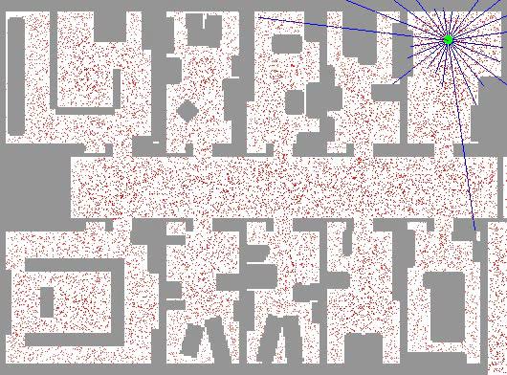
Example Problem

Slide 3
Probabilistic Robotics
Key idea: Explicit representation of uncertainty
(using the calculus of probability theory)
Perception = state estimation
Action = utility optimization

Slide 4
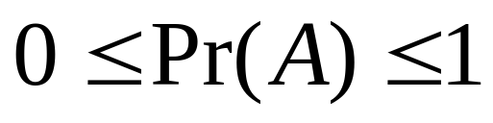
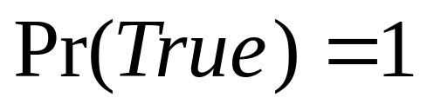
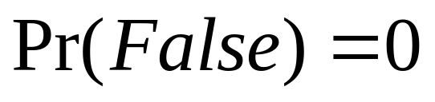
Axioms of Probability Theory
Pr(A) denotes probability that proposition A is true.

Slide 5




A Closer Look at Axiom 3
B

Slide 6
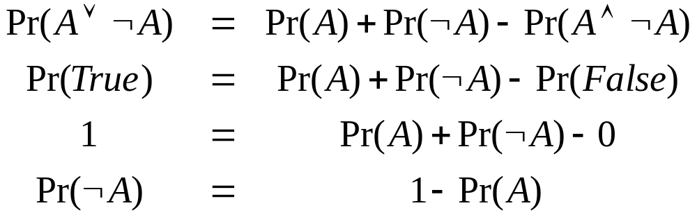
Using the Axioms

Slide 7
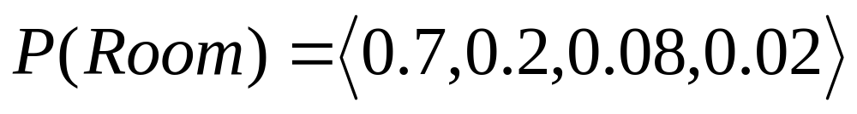
Discrete Random Variables
X denotes a random variable.
X can take on a countable number of values in {x₁, x₂, …, x_{n}}.
P(X=x_{i}), or P(x_{i}), is the probability that the random variable X takes on value x_{i}.
P( ) is called probability mass function.
E.g.
.

Slide 8
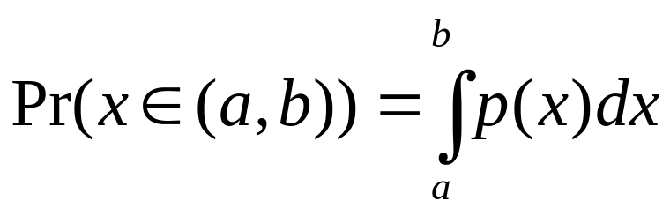
Continuous Random Variables
X takes on values in the continuum.
p(X=x), or p(x), is a probability density function.
E.g.
p(x)
x

Slide 9
Joint and Conditional Probability
P(X=x and Y=y) = P(x,y)
If X and Y are independent then
P(x,y) = P(x) P(y)
P(x | y) is the probability of x given y
P(x | y) = P(x,y) / P(y)
P(x,y) = P(x | y) P(y)
If X and Y are independent then
P(x | y) = P(x)

Slide 10
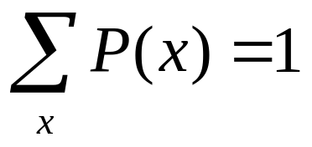
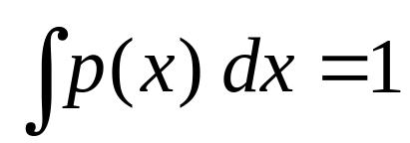
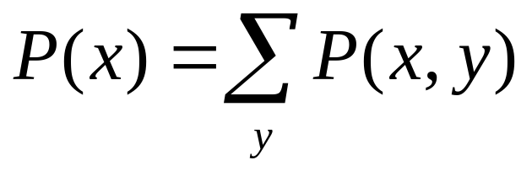
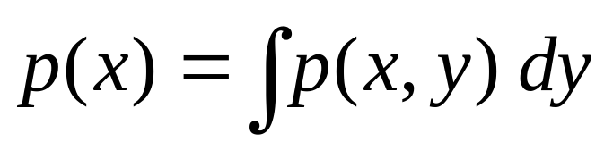
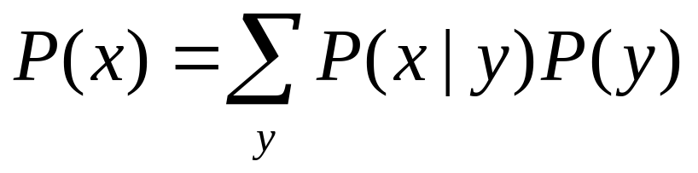
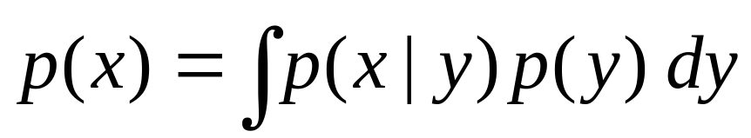
Law of Total Probability, Marginals
Discrete case
Continuous case

Slide 11
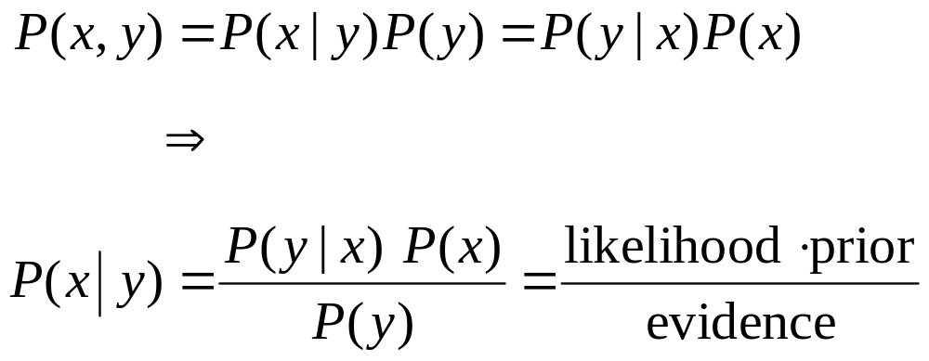
Bayes Formula

Slide 12
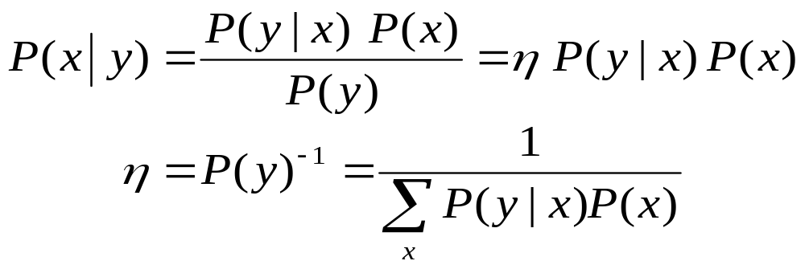
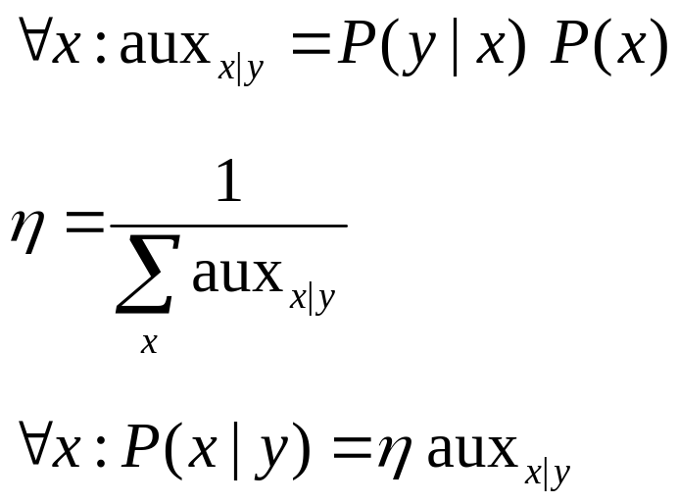
Normalization
Algorithm:

Slide 13
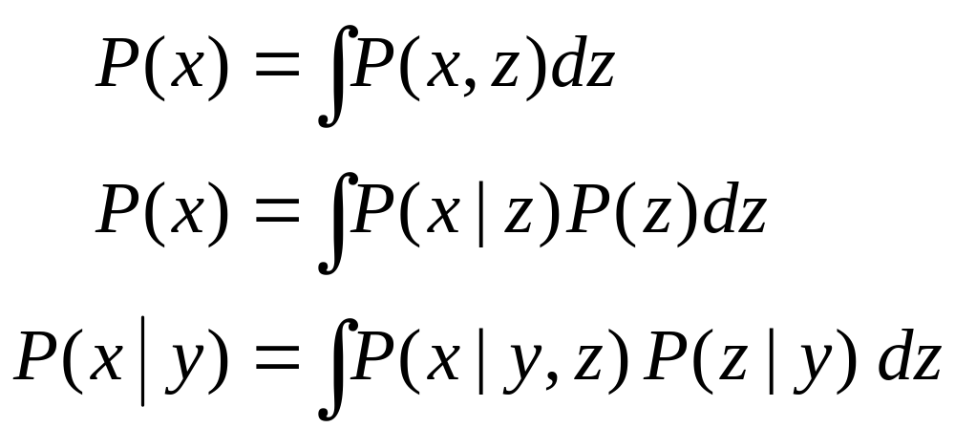
Conditioning
Law of total probability:

Slide 14
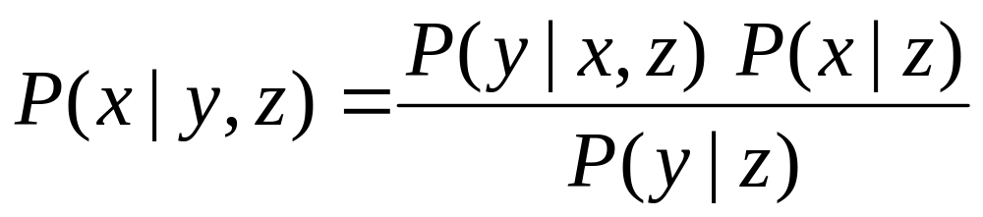
Bayes Rule with Background Knowledge

Slide 15
Conditioning
Total probability:

Slide 16
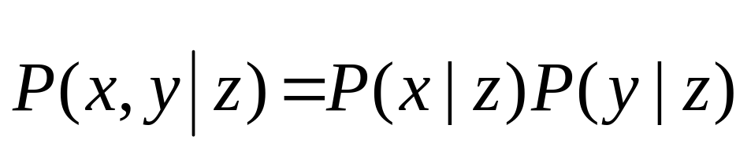
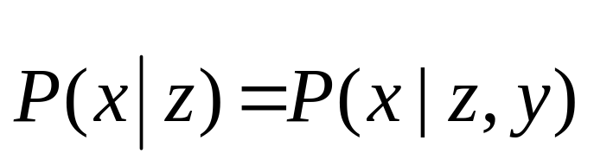
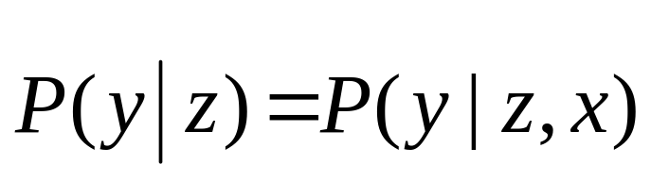
Conditional Independence
Equivalent to
and

Slide 17
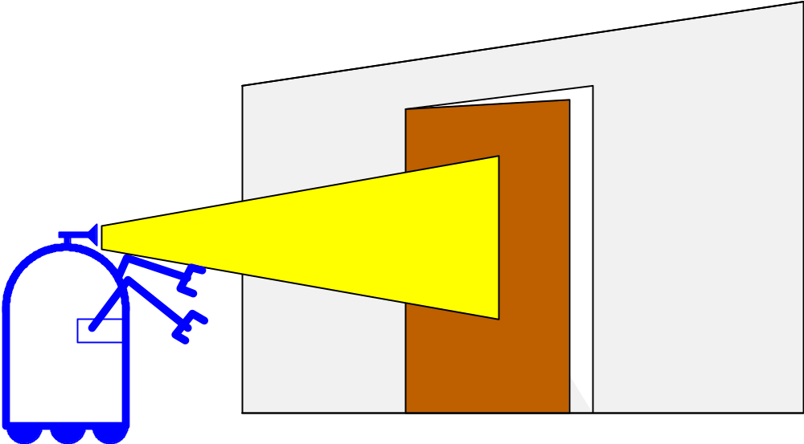
Simple Example of State Estimation
Suppose a robot obtains measurement z
What is P(open|z)?

Slide 18
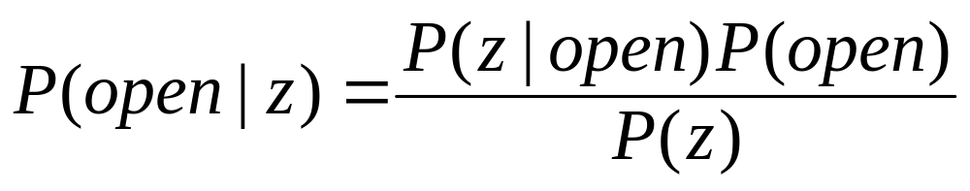
Causal vs. Diagnostic Reasoning
P(open|z) is diagnostic.
P(z|open) is causal.
Often causal knowledge is easier to obtain.
Bayes rule allows us to use causal knowledge:
count frequencies!

Slide 19
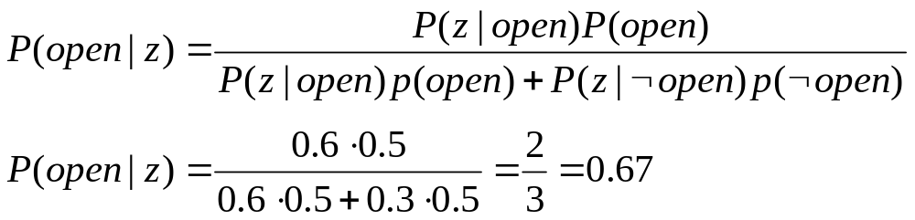
Example
P(z|open) = 0.6 P(z|¬open) = 0.3
P(open) = P(¬open) = 0.5
z raises the probability that the door is open.

Slide 20
Combining Evidence
Suppose our robot obtains another observation z₂.
How can we integrate this new information?
More generally, how can we estimate
P(x| z₁...z_{n} )?

Slide 21
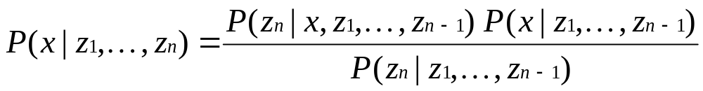
Recursive Bayesian Updating
Markov assumption: z_{n} is independent of z₁,...,z_{n-1} if we know x.

Slide 22
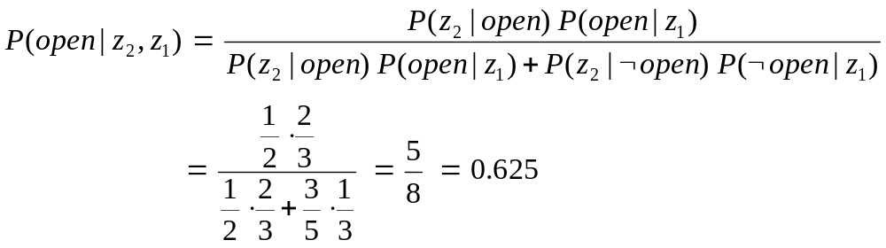
Example: Second Measurement
P(z₂|open) = 0.5 P(z₂|¬open) = 0.6
P(open|z₁)=2/3
z₂ lowers the probability that the door is open.

Slide 23
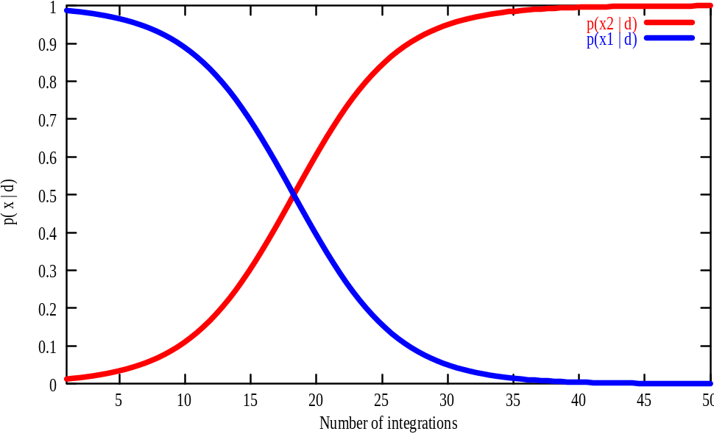
A Typical Pitfall
Two possible locations x₁ and x₂
P(x₁)=0.99
P(z|x₂)=0.09 P(z|x₁)=0.07

Slide 24
Actions
Often the world is dynamic since
  actions carried out by the robot,
  actions carried out by other agents,
  or just the time passing by
change the world.
How can we incorporate such actions?

Slide 25
Typical Actions
The robot turns its wheels to move
The robot uses its manipulator to grasp an object
Plants grow over time…
Actions are never carried out with absolute certainty.
In contrast to measurements, actions generally increase the uncertainty.

Slide 26
Modeling Actions
To incorporate the outcome of an action u into the current “belief”, we use the conditional pdf
P(x|u,x’)
This term specifies the pdf that executing u changes the state from x’ to x.

Slide 27
Example: Closing the door

Slide 28
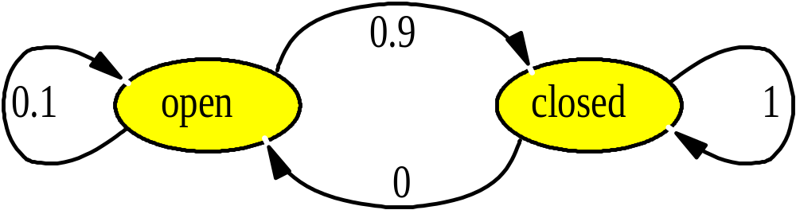
State Transitions
P(x|u,x’) for u = “close door”:
If the door is open, the action “close door” succeeds in 90% of all cases.

Slide 29
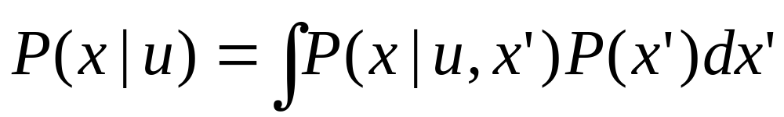
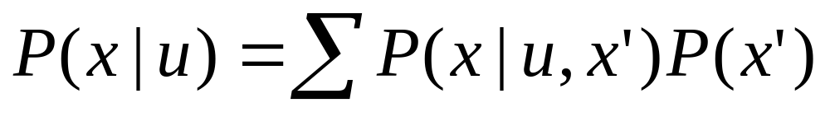
Integrating the Outcome of Actions
Continuous case:
Discrete case:

Slide 30
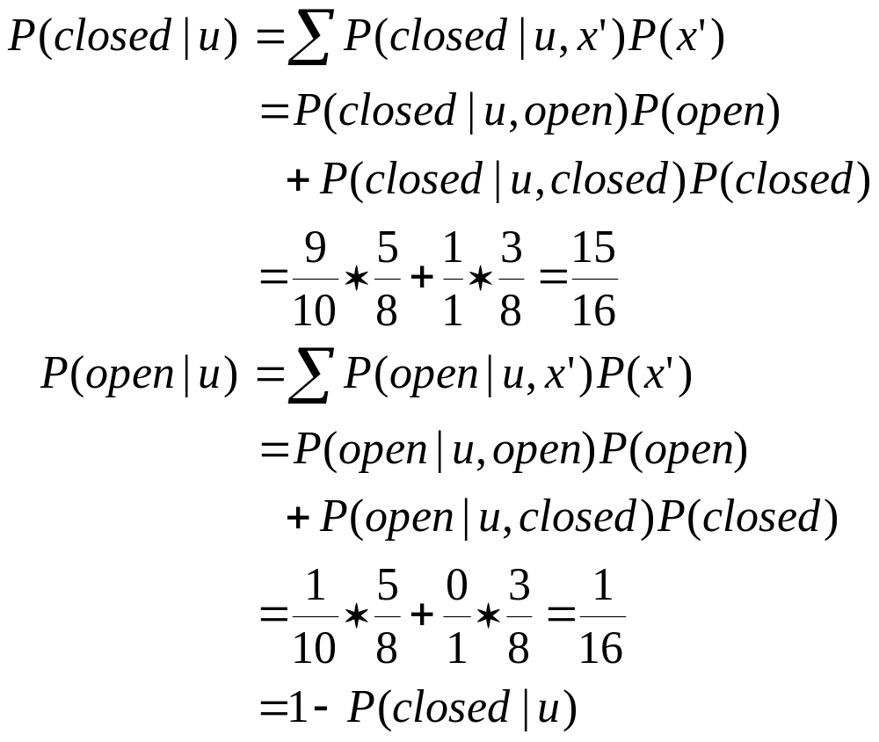
Example: The Resulting Belief

Slide 31
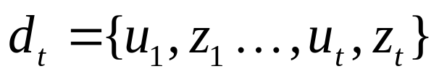
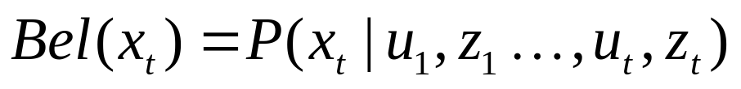
Bayes Filters: Framework
Given:
  Stream of observations z and action data u:
  Sensor model P(z|x).
  Action model P(x|u,x’).
  Prior probability of the system state P(x).
Wanted:
  Estimate of the state X of a dynamical system.
  The posterior of the state is also called Belief:

Slide 32
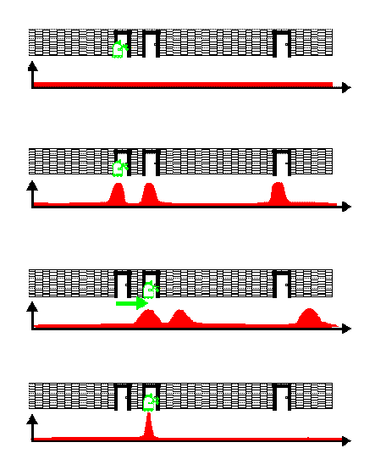
Bayes Filter Example

Slide 33
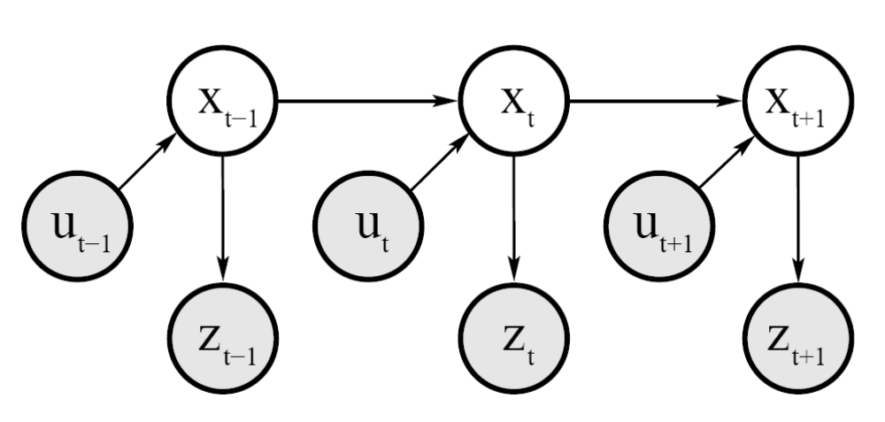
Dynamic Bayesian Network for Controls, States, and Sensations

Slide 34
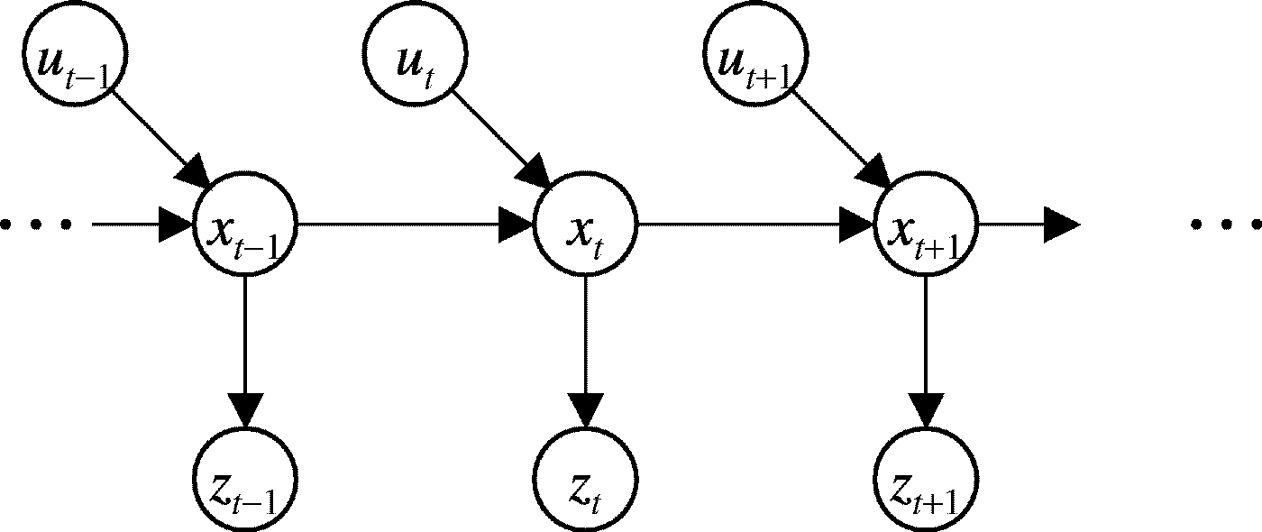
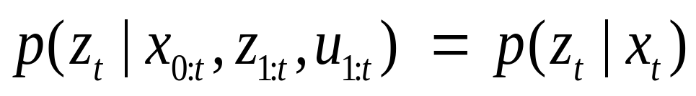
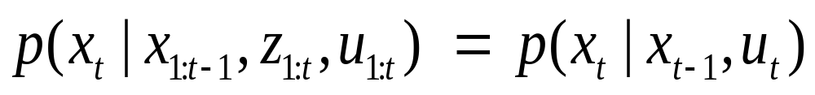
Markov Assumption
Underlying Assumptions
Static world
Independent noise
Perfect model, no approximation errors

Slide 35

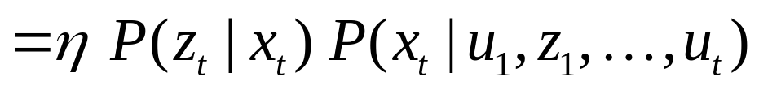
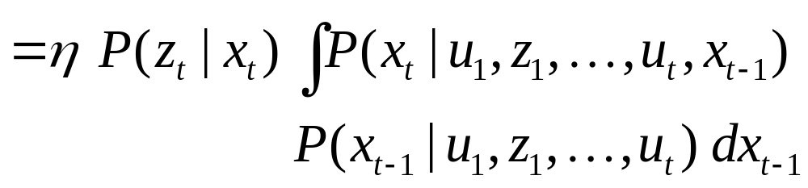
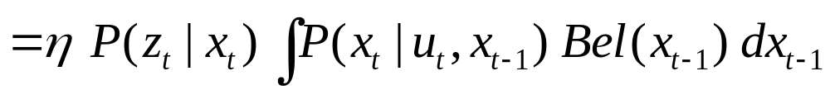
Bayes Filters
z = observation
u = action
x = state
Bayes
Markov
Total prob.
Markov
Markov

Slide 36



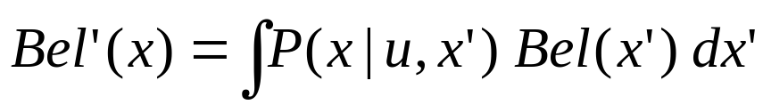
Bayes Filter Algorithm
Algorithm Bayes_filter( Bel(x),d ):
η=0
If d is a perceptual data item z then
For all x do
For all x do
Else if d is an action data item u then
For all x do
Return Bel’(x)

Slide 37
Bayes Filters are Familiar!
Kalman filters
Particle filters
Hidden Markov models
Dynamic Bayesian networks
Partially Observable Markov Decision Processes (POMDPs)

Slide 38
Bayes Filters in Localization

Slide 39
Summary
Bayes rule allows us to compute probabilities that are hard to assess otherwise.
Under the Markov assumption, recursive Bayesian updating can be used to efficiently combine evidence.
Bayes filters are a probabilistic tool for estimating the state of dynamic systems.

